Slide 1
Digital Education Strategy Review 2021
Oxford Ideas Platform - Guidance

Slide 2
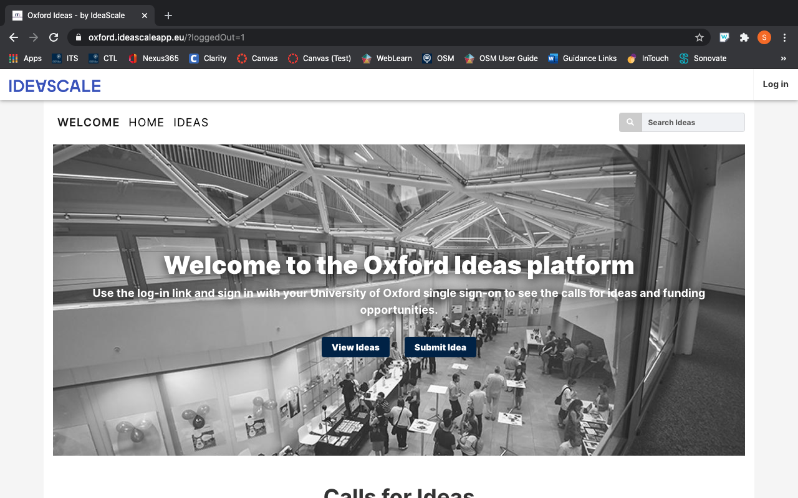
Oxford Ideas (powered by IdeaScale)
As part of the Digital Education Strategy Review, Oxford Ideas has been selected as the consultation platform to manage the submission of your ideas.

Slide 3
Accessing Oxford Ideas
Oxford Ideas can be accessed here - https://oxford.ideascaleapp.eu/
You will need to log in using your University SSO credentials

Slide 4
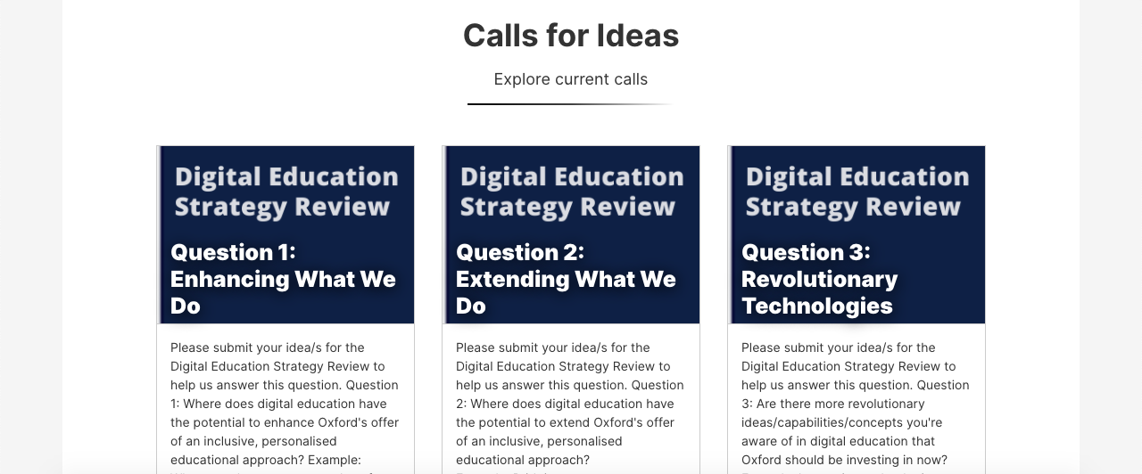
Calls for Ideas/Questions
Upon log in, scroll down to view the active Calls for Ideas. There are currently three, Questions 1/2/3, which are grouped under the Digital Education Strategy Review.

Slide 5
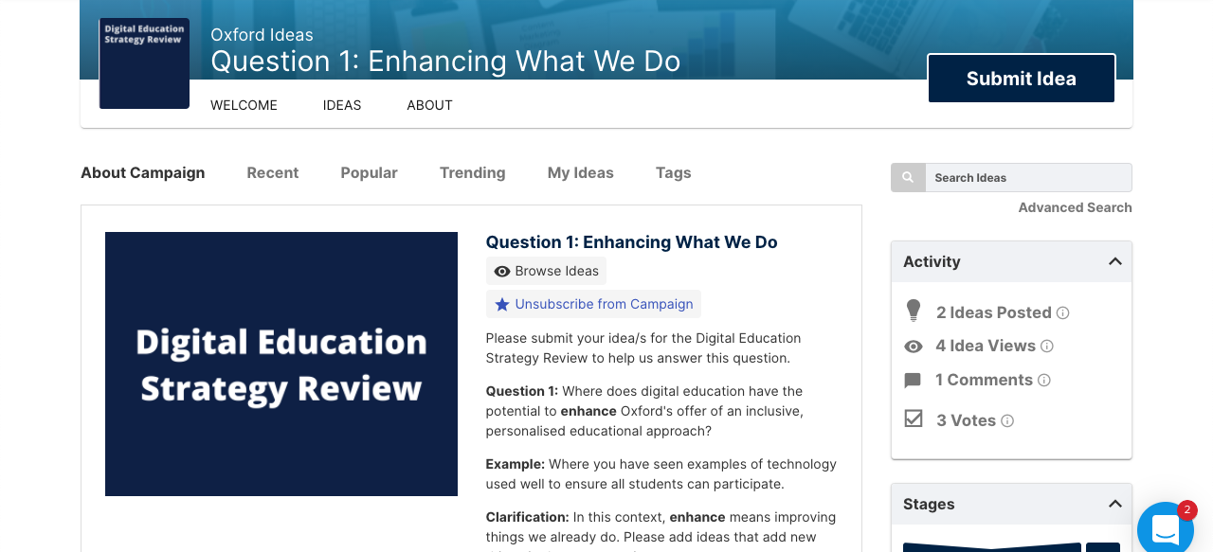
About Campaign
Clicking on one of the Questions will navigate you to the About Campaign page. Here you will find more information on what needs to be considered when you Submit an Idea.

Slide 6
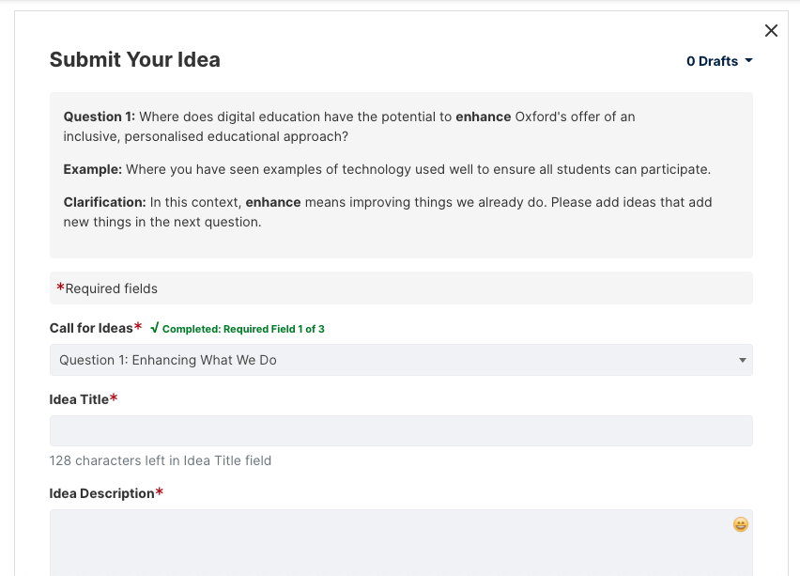
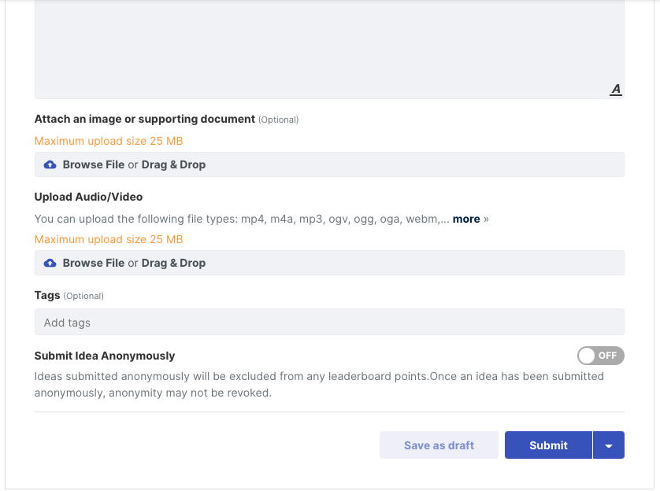
Submit Your Idea
You will see the Question at the top. Fill in the mandatory fields and relevant optional fields. We encourage the upload of video recordings explaining your idea.

Slide 7
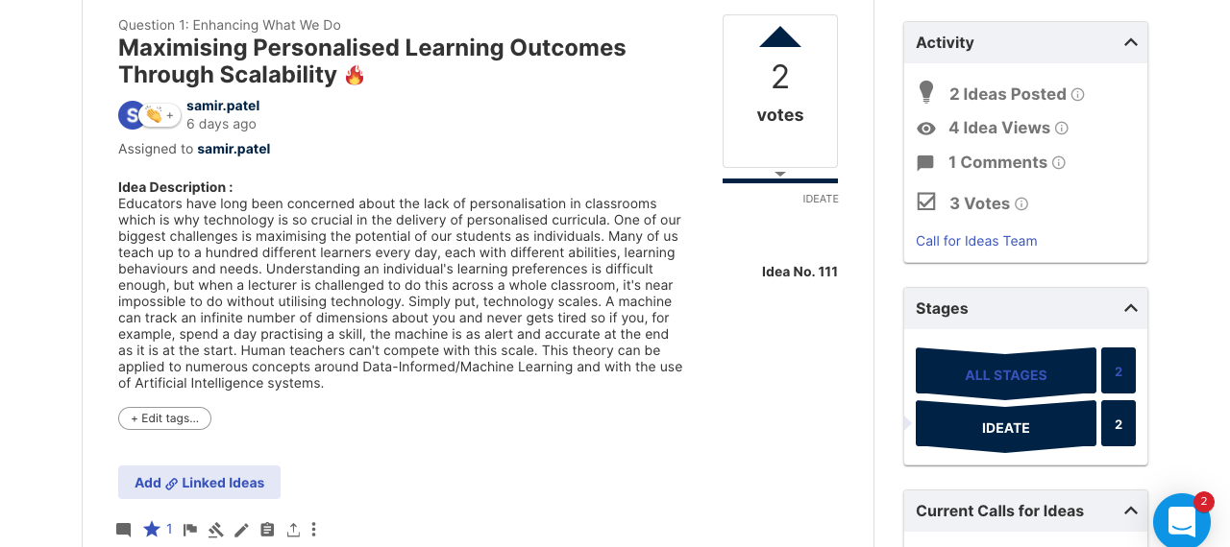
Review Your Idea
You will now be able to see your submitted idea. This is a good opportunity to review it incase you want to make any additions or amendments.

Slide 8
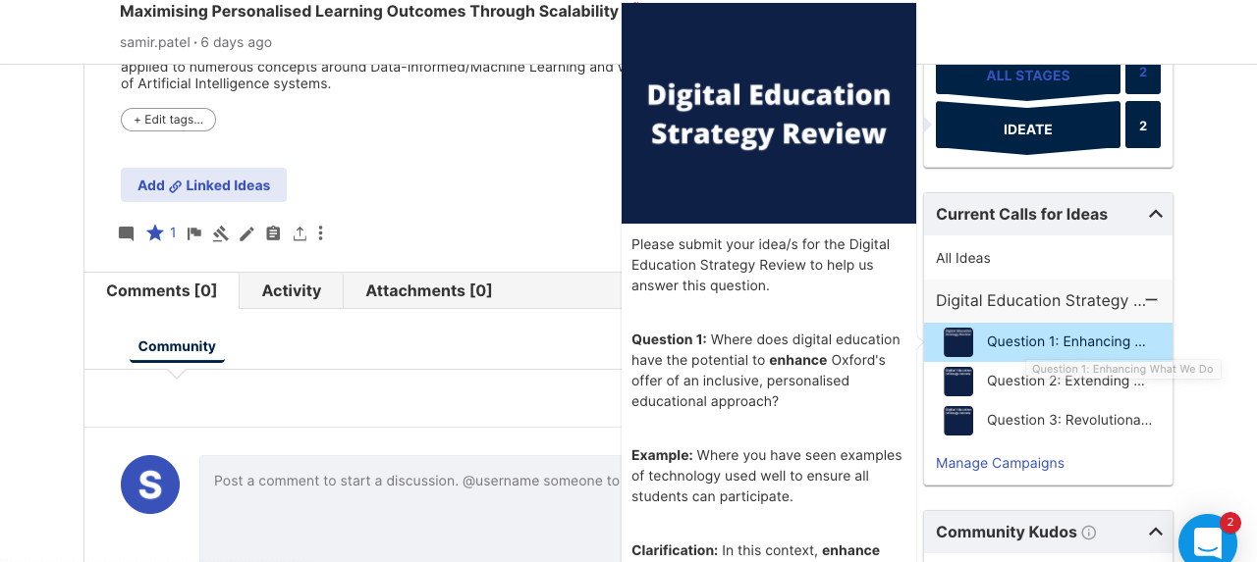
Navigation
Scroll down until you see the Current Calls for Ideas box. You can hover over each question to view further information or click on it to navigate to its About page.

Slide 9
Review Others' Ideas
From an About Campaign page, you can review others’ ideas. They’re sorted by; reverse chronological order (Recent), votes (Popular), kudos (Trending).

Slide 10
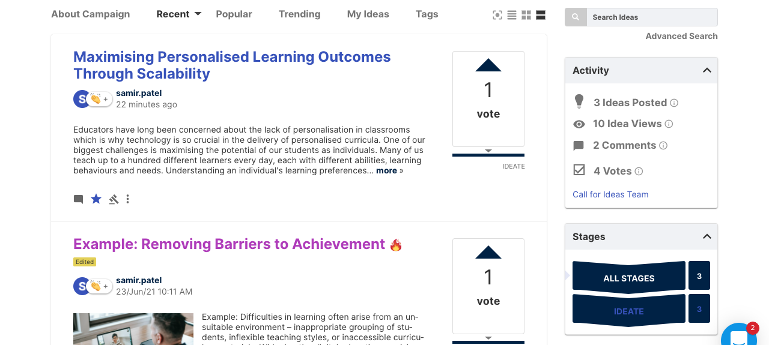
Voting/Kudos/Comments
When reviewing ideas, you can (1) vote, (2) give kudos which is linked to a leaderboard, (3) leave comments. Click buttons once to give and again to retract (excludes comments).
1
2
3

Slide 11
Direct Links to Questions
You can use the direct links below to navigate to each one of the Digital Education Strategy Review, Calls for Ideas.
Question 1 - https://oxford.ideascaleapp.eu/a/campaign-home/435
Question 2 - https://oxford.ideascaleapp.eu/a/campaign-home/436
Question 3 - https://oxford.ideascaleapp.eu/a/campaign-home/439

